Slide 1
IT-331 ( Computer Graphics 1)
Lecture 3
Line - Drawing Algorithms Bresenham
Dr. Mohammed El-Said
Assistant Professor, Computer Science Dept.,
Faculty of Computers & Artificial Intelligence,
Helwan University - Cairo, Egypt.

Slide 2
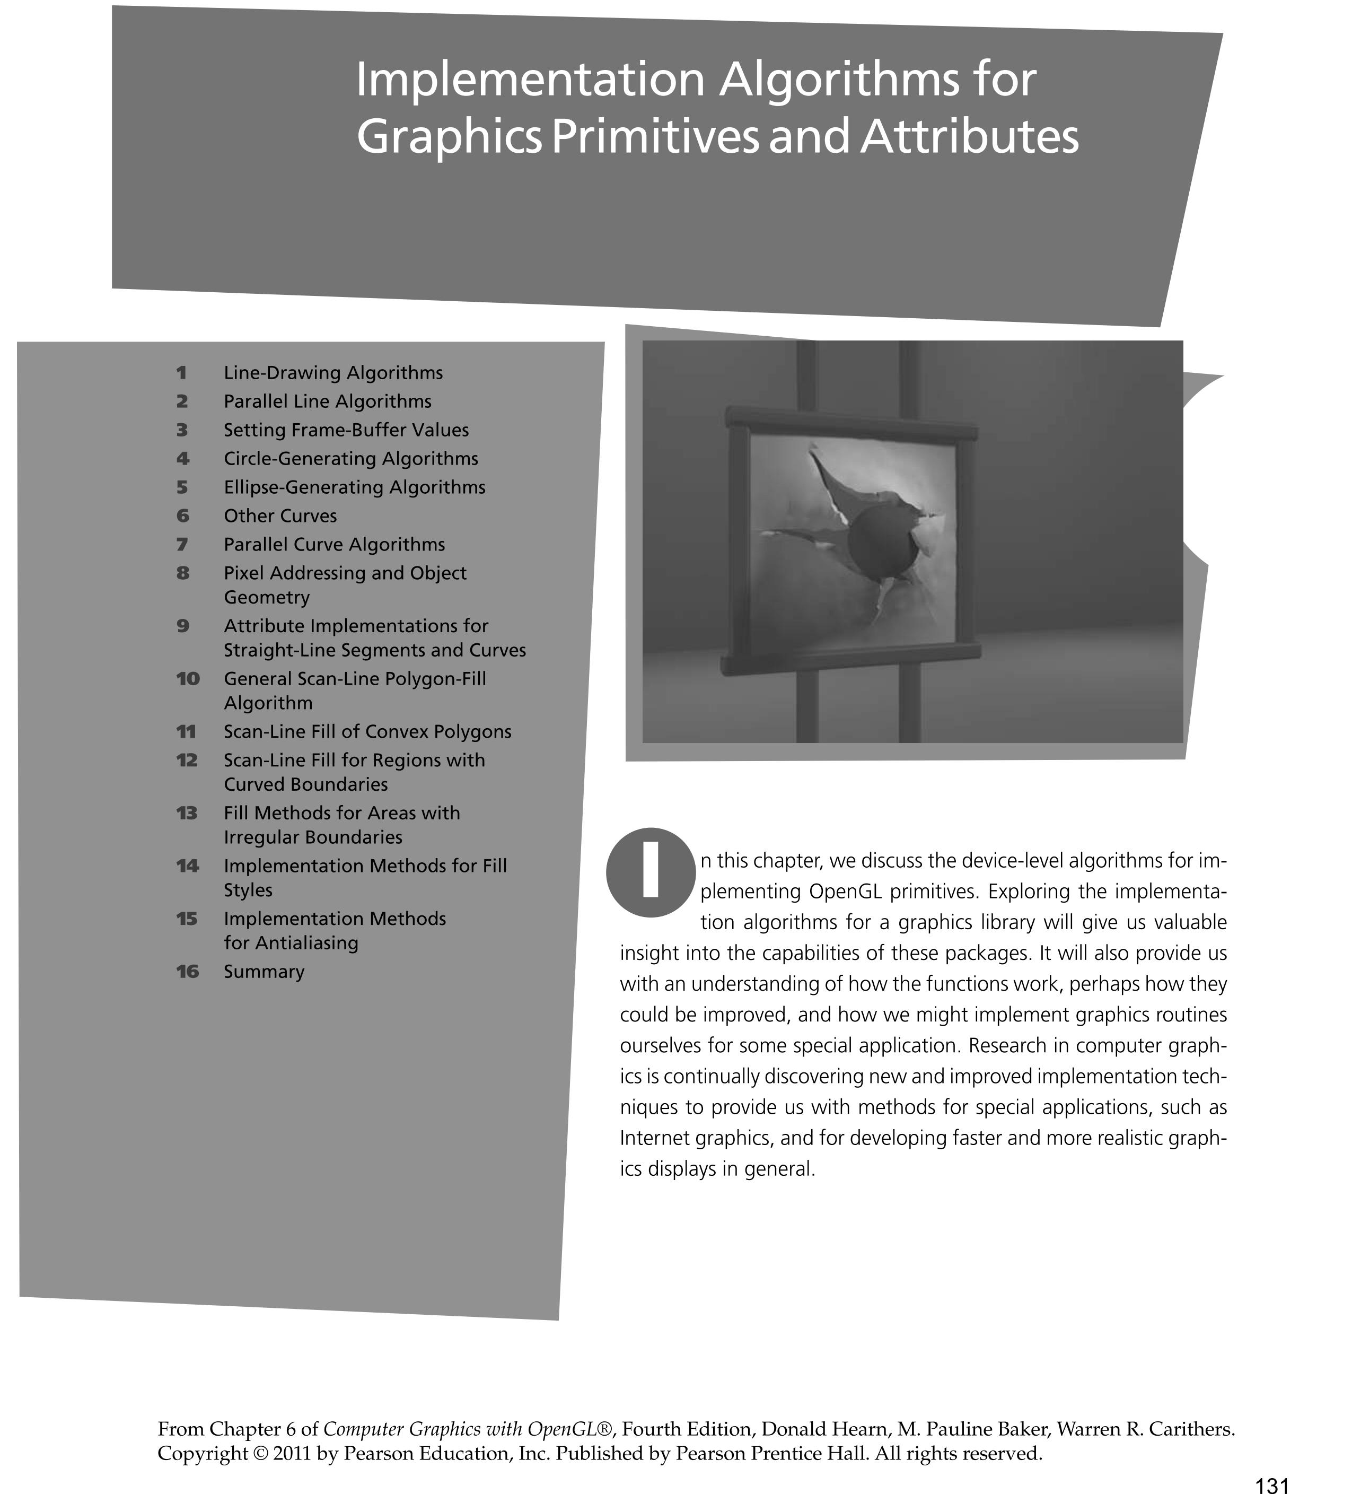

Slide 3
Bresenham's line algorithm
Accurate and efficient
Uses only incremental integer calculations
The method is described for a line segment with a positive slope less than one
The method generalizes to line segments of other slopes by considering the symmetry between the various octants and quadrants of the xy plane

Slide 4
Bresenham's line algorithm
Decide what is the next pixel position
(11,11) or (11,12)
13
Specified
line path
12
11
10
10
11
12
13

Slide 5
Illustrating Bresenham’s Approach
For the pixel position x_{k+1}=x_{k}+1, which one we should choose:
(x_{k+1},y_{k}) or (x_{k+1}, y_{k+1})
y_{k+3}
y_{k+2}
y=mx+b
y_{k+1}
y_{k}
x_{k}
x_{k+1}
x_{k+2}
x_{k+3}

Slide 6
Bresenham’s Approach
y=m(x_{k} + 1)+b
d_{lower}=y-y_{k}
=m(x_{k} + 1)+b-y_{k}
d_{upper}=(y_{k}+1)-y
= y_{k}+1 -m(x_{k} + 1)-b
y_{k+1}
d_{upper}
y
d_{lower}
y_{k}
x_{k+1}
d_{lower}- d_{upper}= 2m(x_{k} + 1)+2y_{k}+2b-1
Rearrange it to have integer calculations:
m=Δy/Δx
Decision parameter: p_{k}= Δx(d_{lower}- d_{upper})=2Δy.x_{k} - 2Δx. y_{k} + c

Slide 7
The Decision Parameter
Decision parameter: p_{k}= Δx(d_{lower}- d_{upper})=2Δy.x_{k} - 2Δx. y_{k} + c
p_{k} has the same sign with d_{lower}- d_{upper} since Δx>0.
c is constant and has the value c= 2Δy + Δx(2b-1)
c is independent of the pixel positions and is eliminated from decision parameter p_{k}.
If d_{lower}< d_{upper} then p_{k} is negative.
Plot the lower pixel (East)
Otherwise
Plot the upper pixel (North East)

Slide 8
Succesive decision parameter
At step k+1
p_{k+1}= 2Δy.x_{k+1} - 2Δx. y_{k+1} + c
Subtracting two subsequent decision parameters yields:
p_{k+1}-p_{k}= 2Δy.(x_{k+1}-x_{k}) - 2Δx. (y_{k+1}-y_{k})
x_{k+1}=x_{k}+1 so
p_{k+1}= p_{k} + 2Δy - 2Δx. (y_{k+1}-y_{k})
y_{k+1}-y_{k} is either 0 or 1 depending on the sign of p_{k}
First parameter p₀
p₀=2 Δy - Δx

Slide 9
Bresenham's Line-Drawing Algorithm for I m I < 1
1. Input the two line endpoints and store the left endpoint in (x₀ ,y₀).
2. Load (x₀ ,y₀) into the frame buffer; that is, plot the first point.
3. Calculate constants Δx, Δy, 2Δy, and 2Δy - 2Δx, and obtain the starting value for the decision parameter as
p₀=2 Δy - Δx
4. At each x_{k} along the line, starting at k = 0, perform the following test:
If p_{k} < 0, the next point to plot is (x_{k+1}, y_{k}) and
p_{k+1}=p_{k} + 2Δy
Otherwise, the next point to plot is (x_{k+1}, y_{k+1}) and
p_{k+1}=p_{k} + 2Δy - 2Δx
5. Repeat step 4 Δx -1 times.

Slide 10
Trivial Situations: Do not need Bresenham

Slide 11
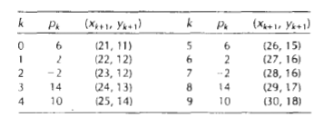
Example
Draw the line with endpoints (20,10) and (30, 18).
Δx=30-20=10, Δy=18-10=8,
p₀ = 2Δy – Δx=16-10=6
2Δy=16, and 2Δy - 2Δx=-4
Plot the initial position at (20,10), then

Slide 12
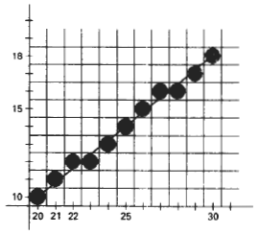
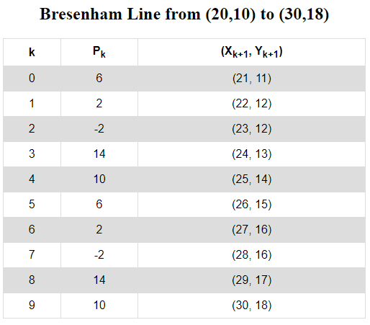

Slide 13
Example
Line end points:
Deltas:
initially

Slide 14
Graph
13
12 11 10 9 8 7 6
4 5 6 7 8 9 10 11

Slide 15
Continue the process...
13
12 11 10 9 8 7 6
4 5 6 7 8 9 10 11

Slide 16
Graph
13
12 11 10 9 8 7 6
4 5 6 7 8 9 10 11

Slide 17
Graph
13
12 11 10 9 8 7 6
4 5 6 7 8 9 10 11

Slide 18
Graph
13
12 11 10 9 8 7 6
4 5 6 7 8 9 10 11

Slide 19
/* Bresenham line-drawing procedure for |m| < 1.0. */
void lineBres (int x0, int y0, int xEnd, int yEnd)
{
int dx = fabs (xEnd - x0), dy = fabs(yEnd - y0);
int x, y, p = 2 * dy - dx;
int twoDy = 2 * dy, twoDyMinusDx = 2 * (dy - dx);
/* Determine which endpoint to use as start position. */
if (x0 > xEnd) {
x = xEnd; y = yEnd; xEnd = x0;
}
else {
x = x0; y = y0;
}
setPixel (x, y);
while (x < xEnd) {
x++;
if (p < 0)
p += twoDy;
else {
y++;
p += twoDyMinusDx;
}
setPixel (x, y);
}
}

Slide 20
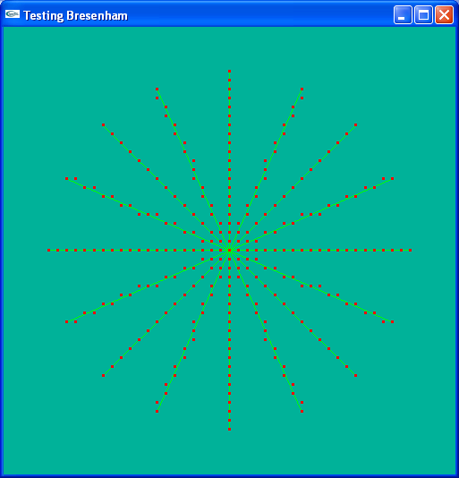
Simulating the Bresenham algorithm in drawing 8 radii on a circle of radius 20
Horizontal, vertical and ±45° radii handled as special cases

Slide 21
Line-drawing algorithm should work in every octant, and special cases
m<-1
m>1
0>m>-1
0<m<1
0<m<1
0>m>-1
m>1
m<-1

Slide 22
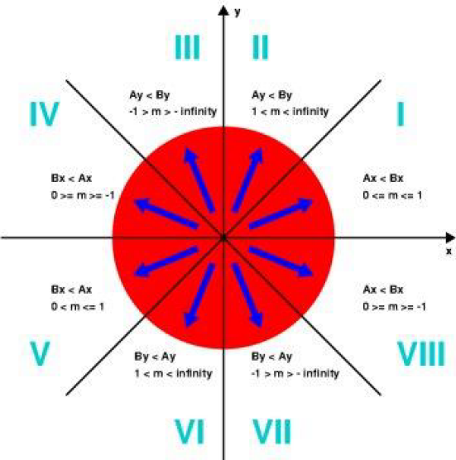

Slide 23
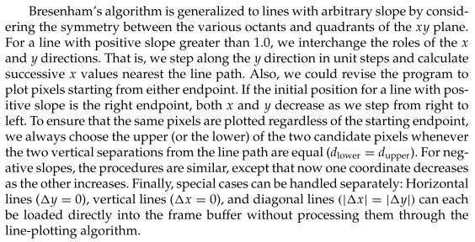

Slide 24
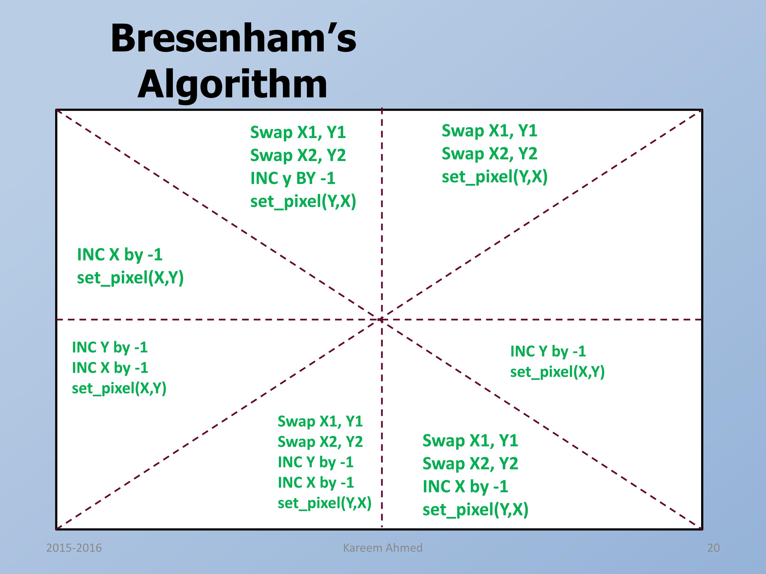

Slide 25
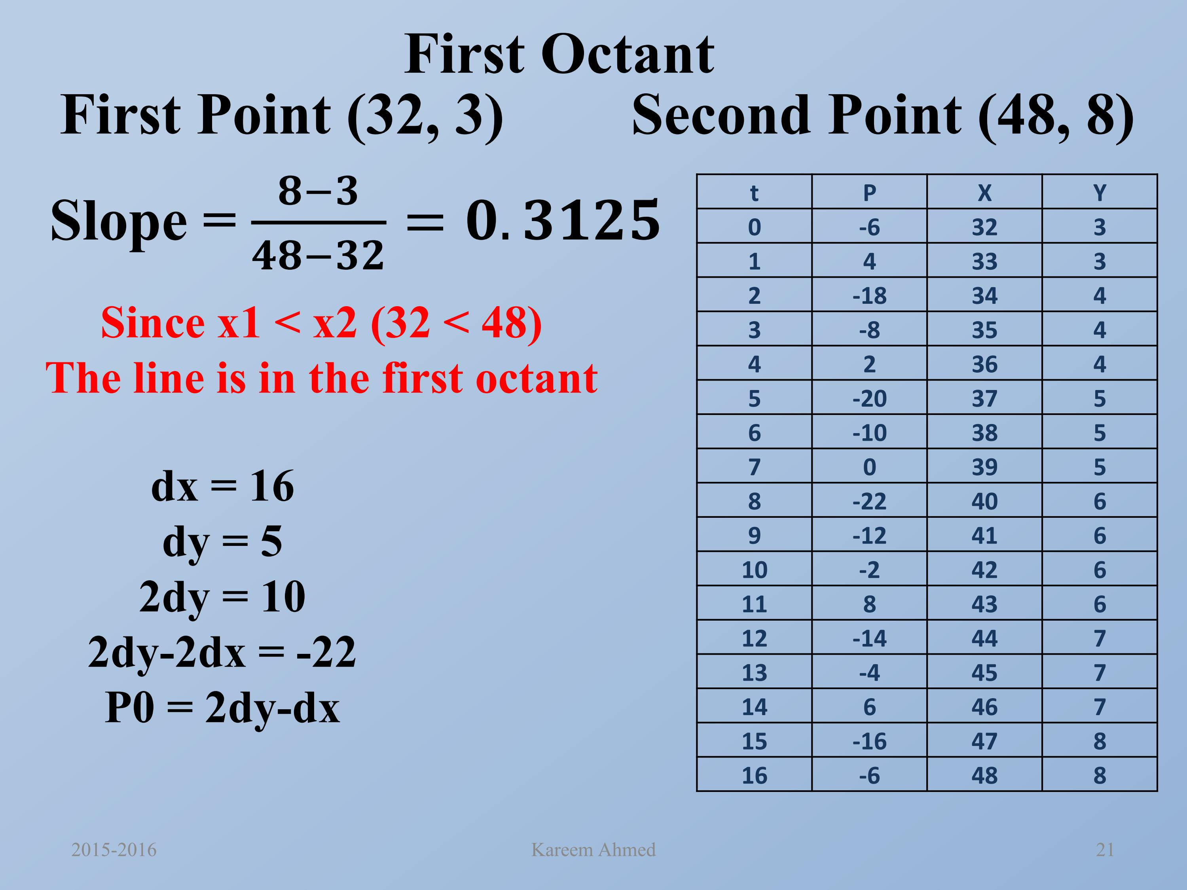
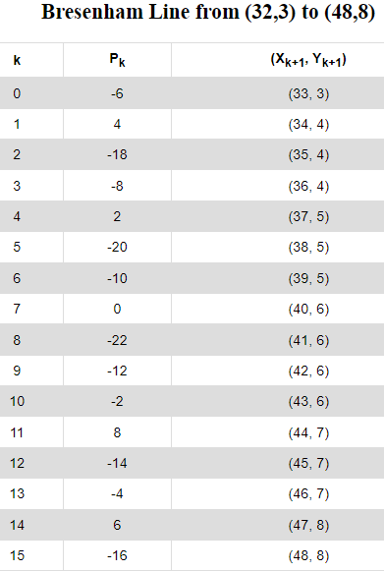

Slide 26
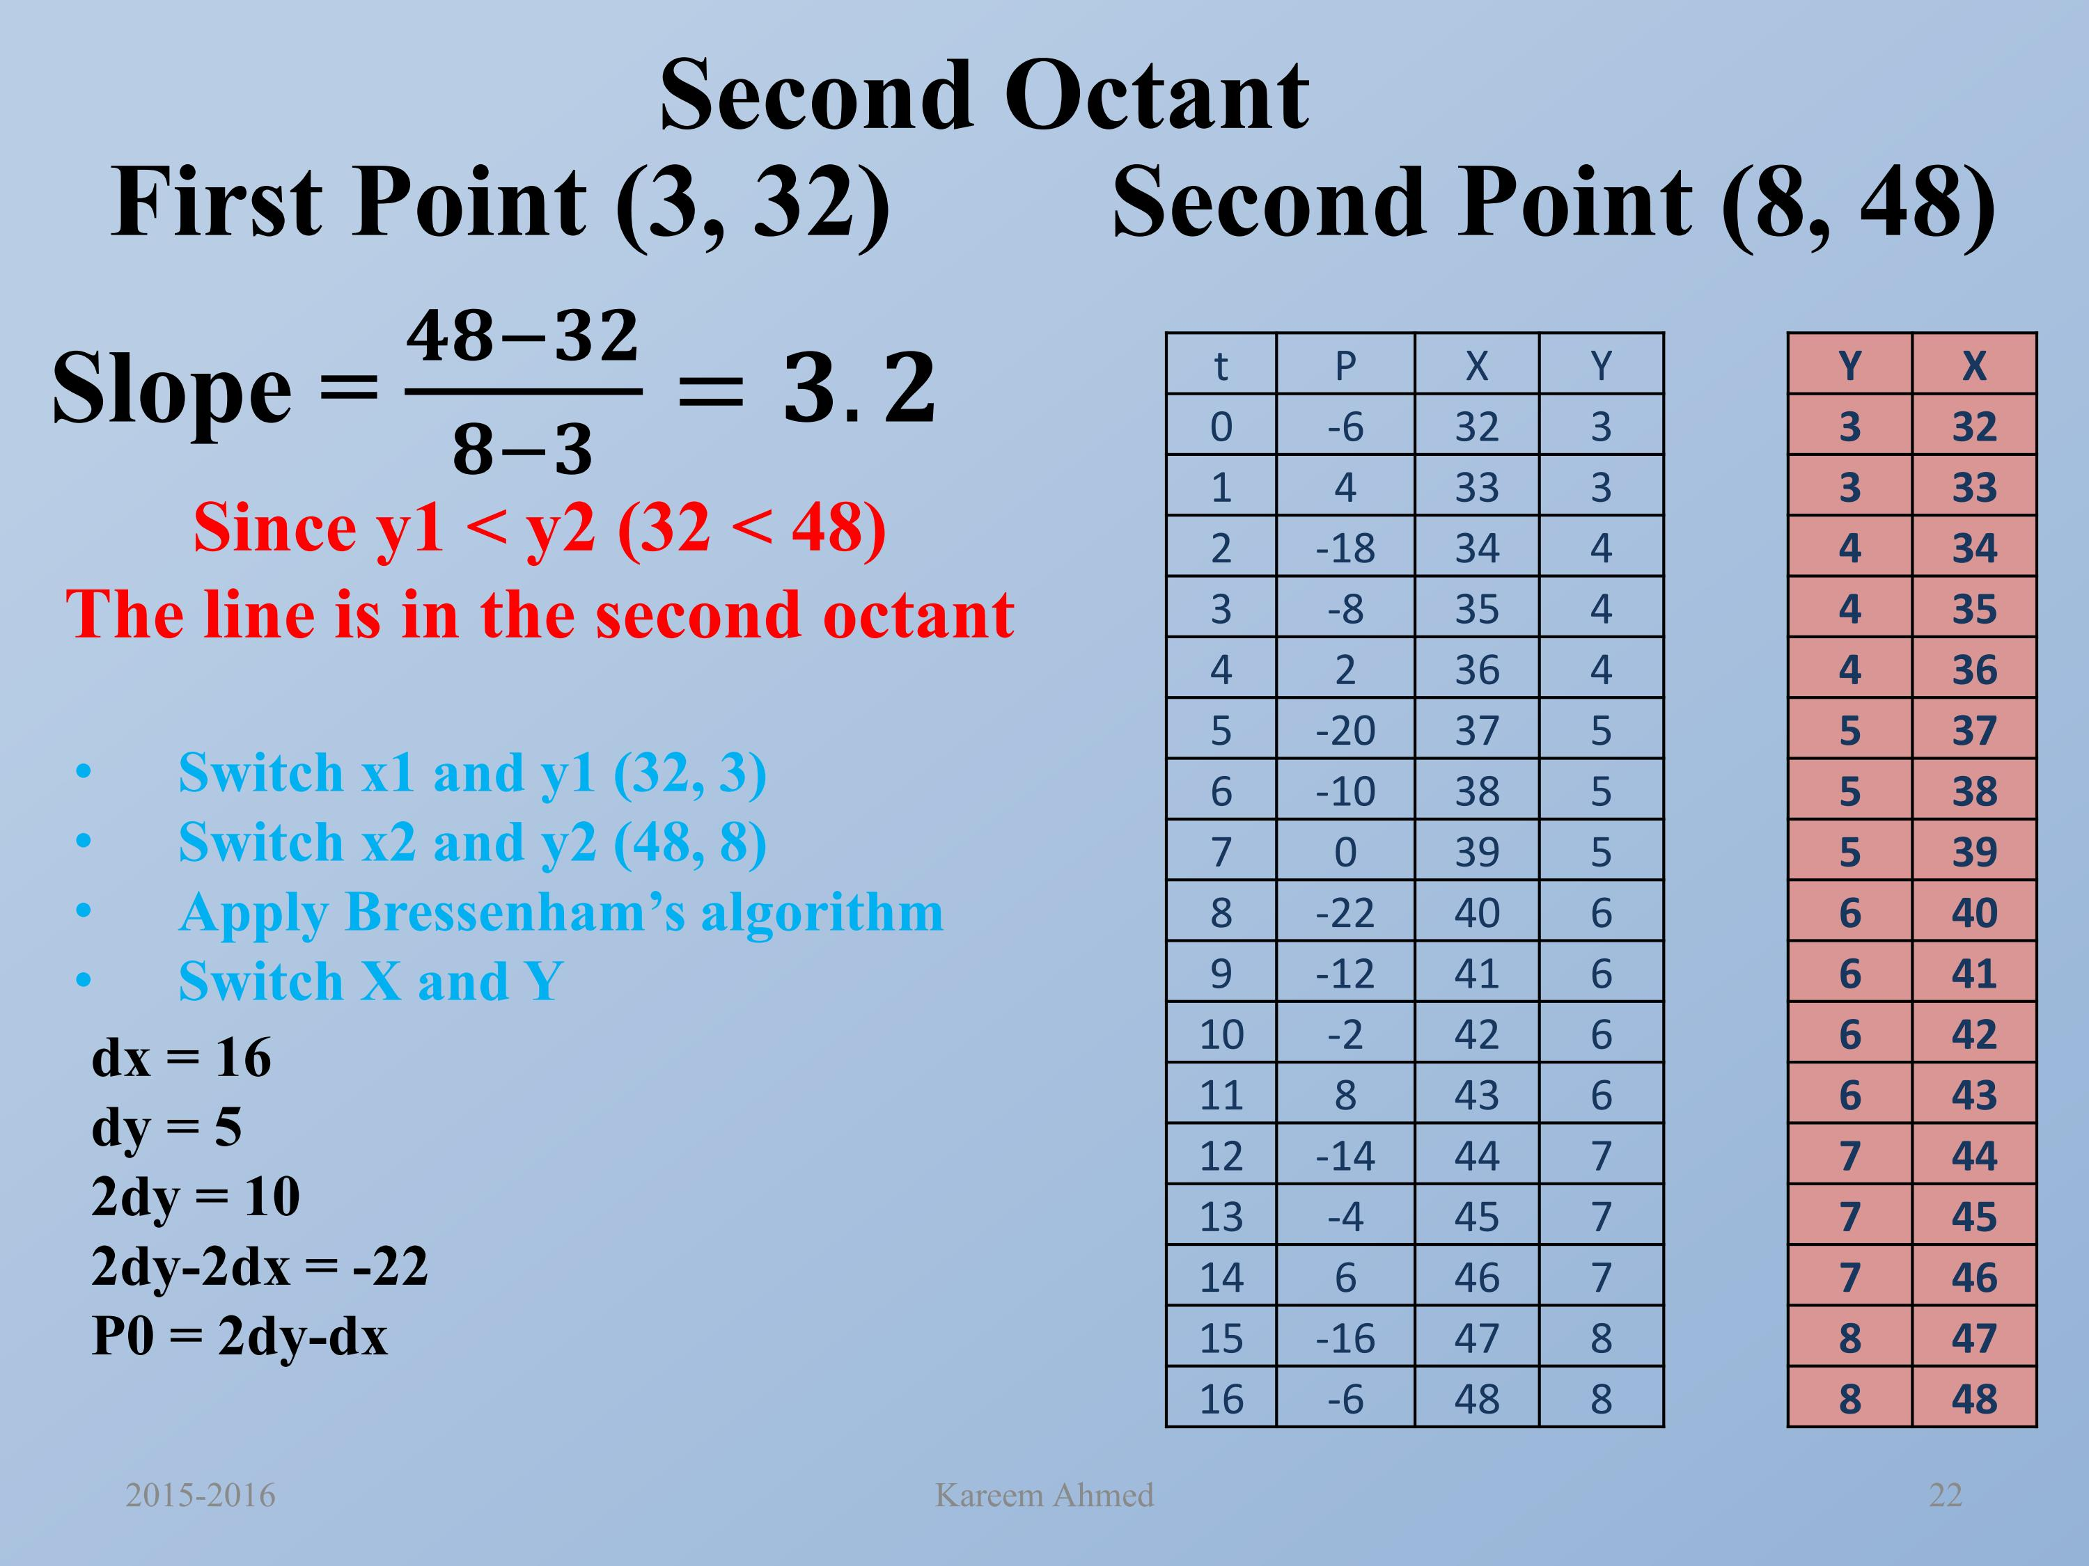
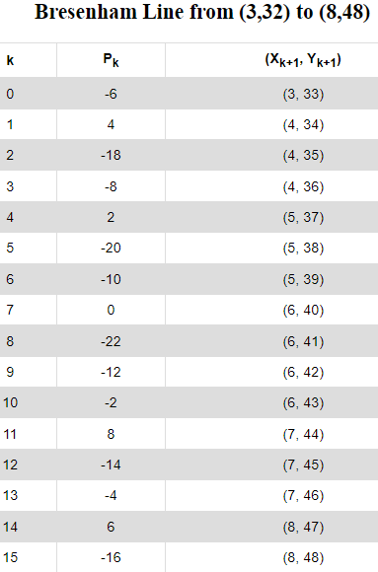

Slide 27
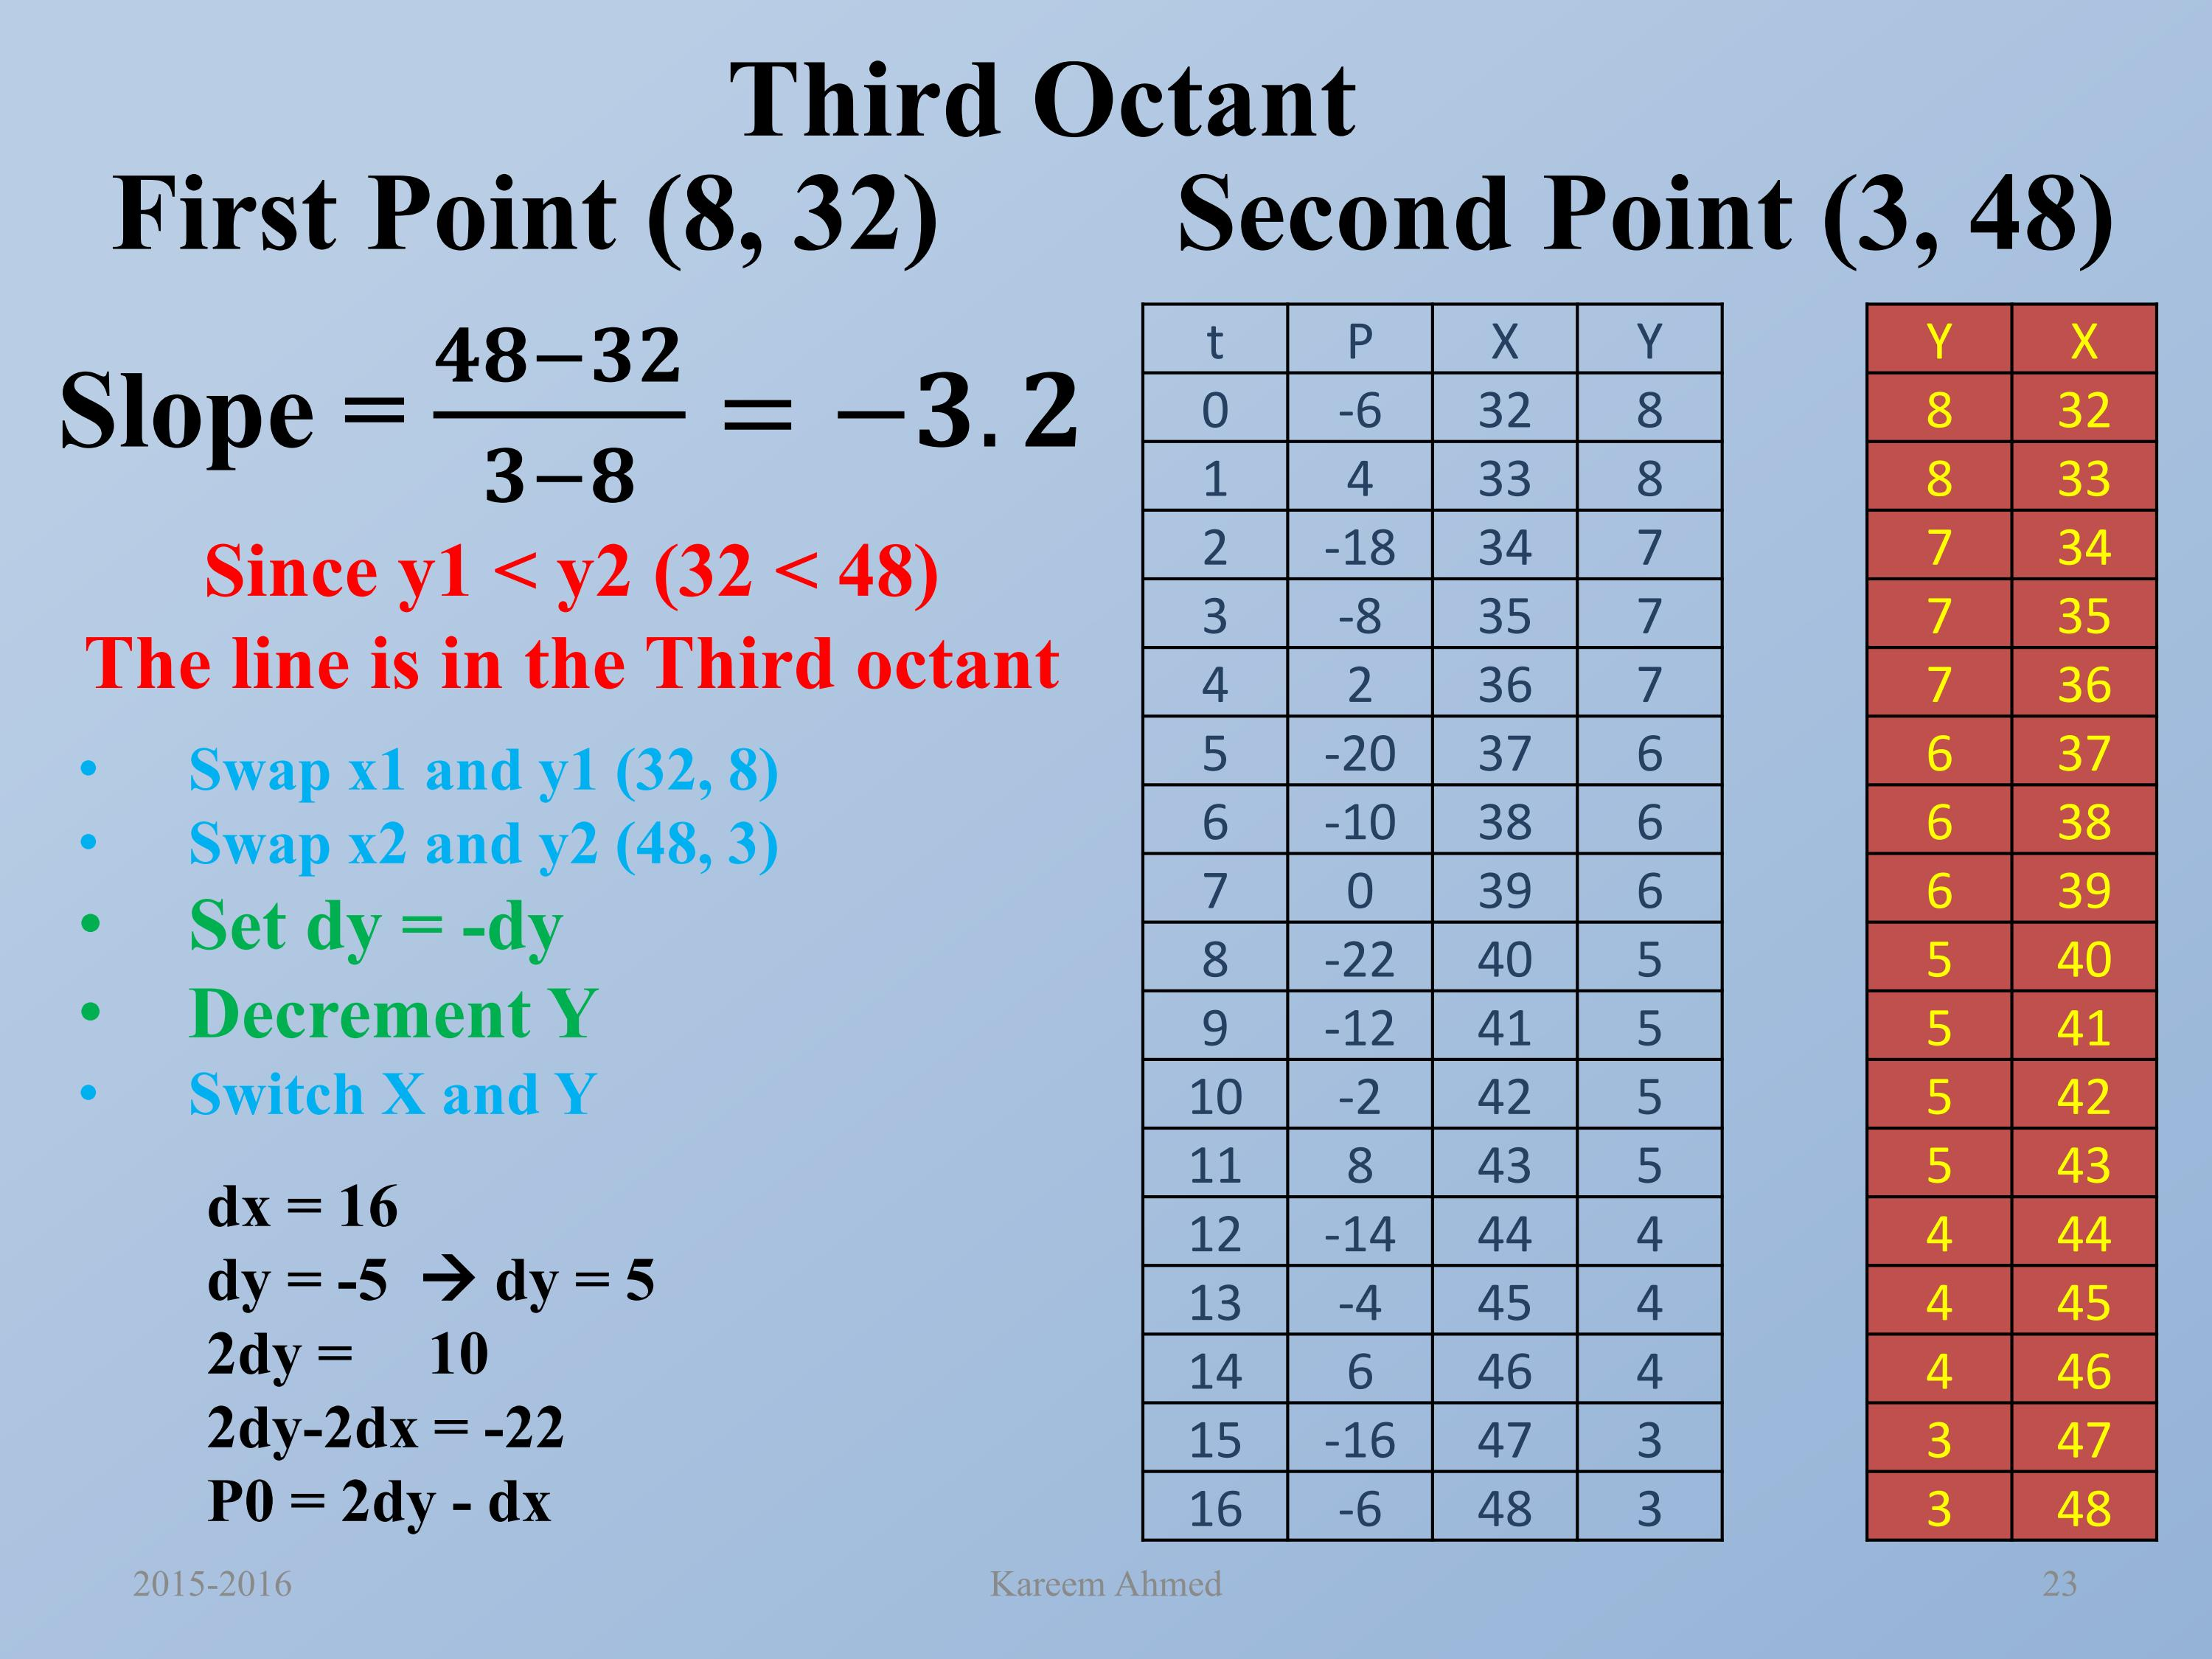
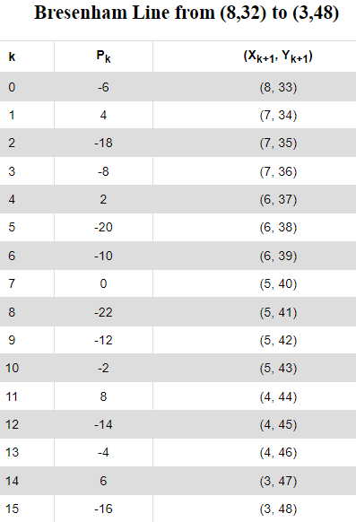

Slide 28
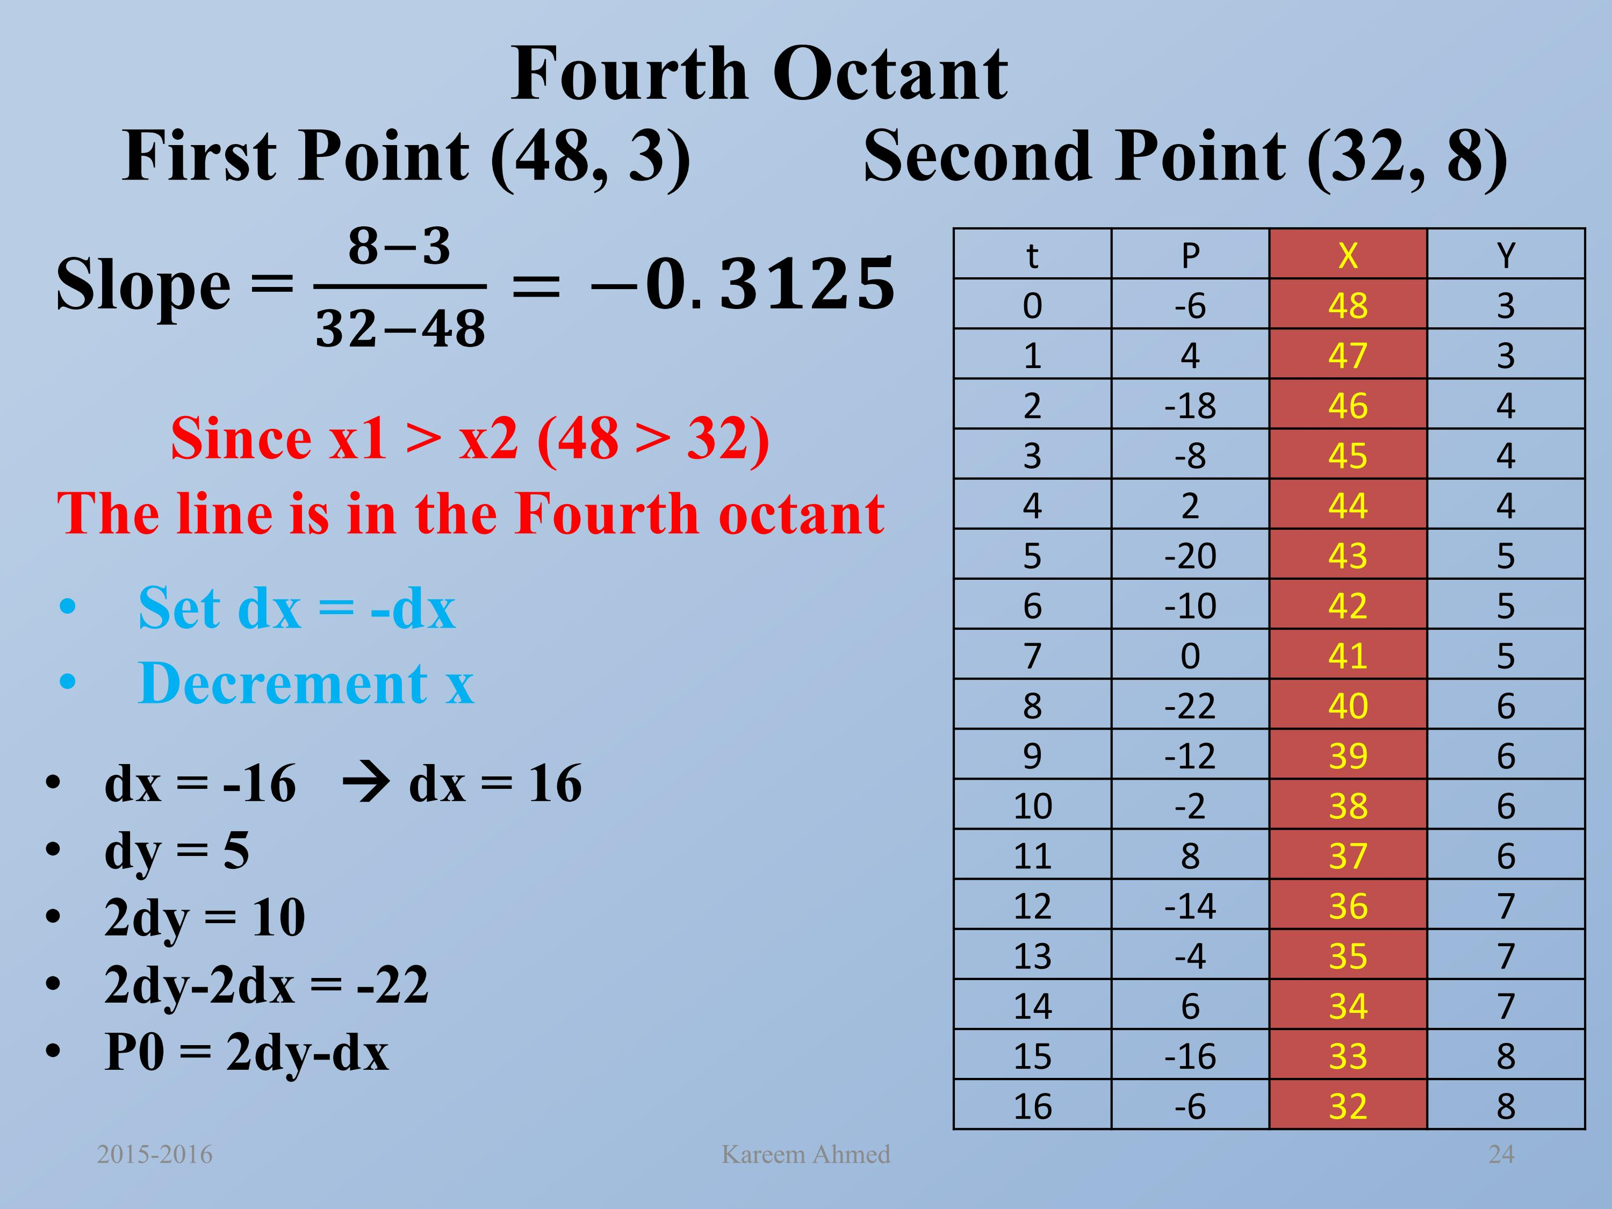
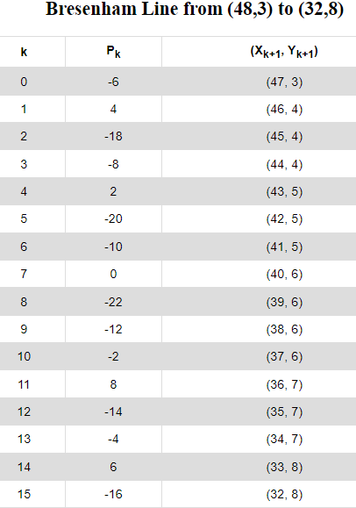

Slide 29
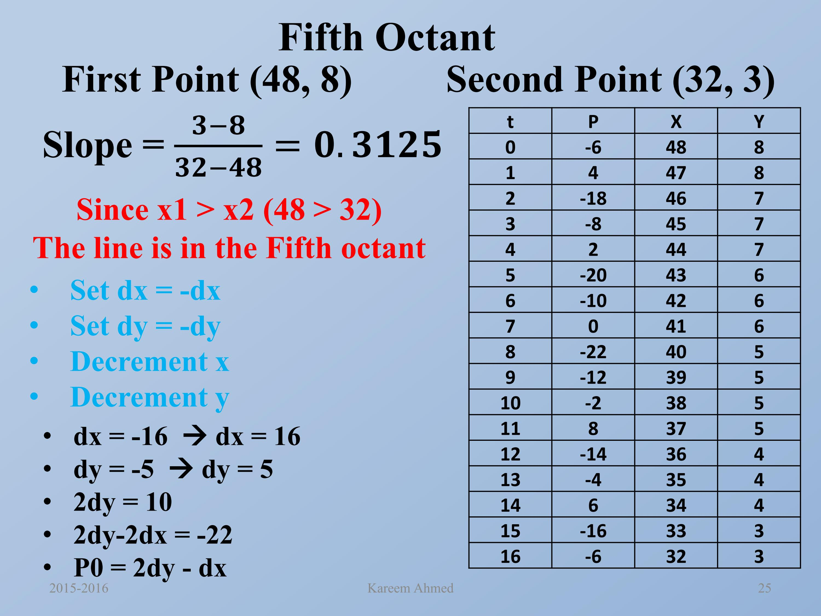
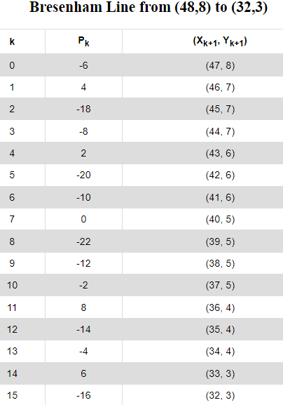

Slide 30
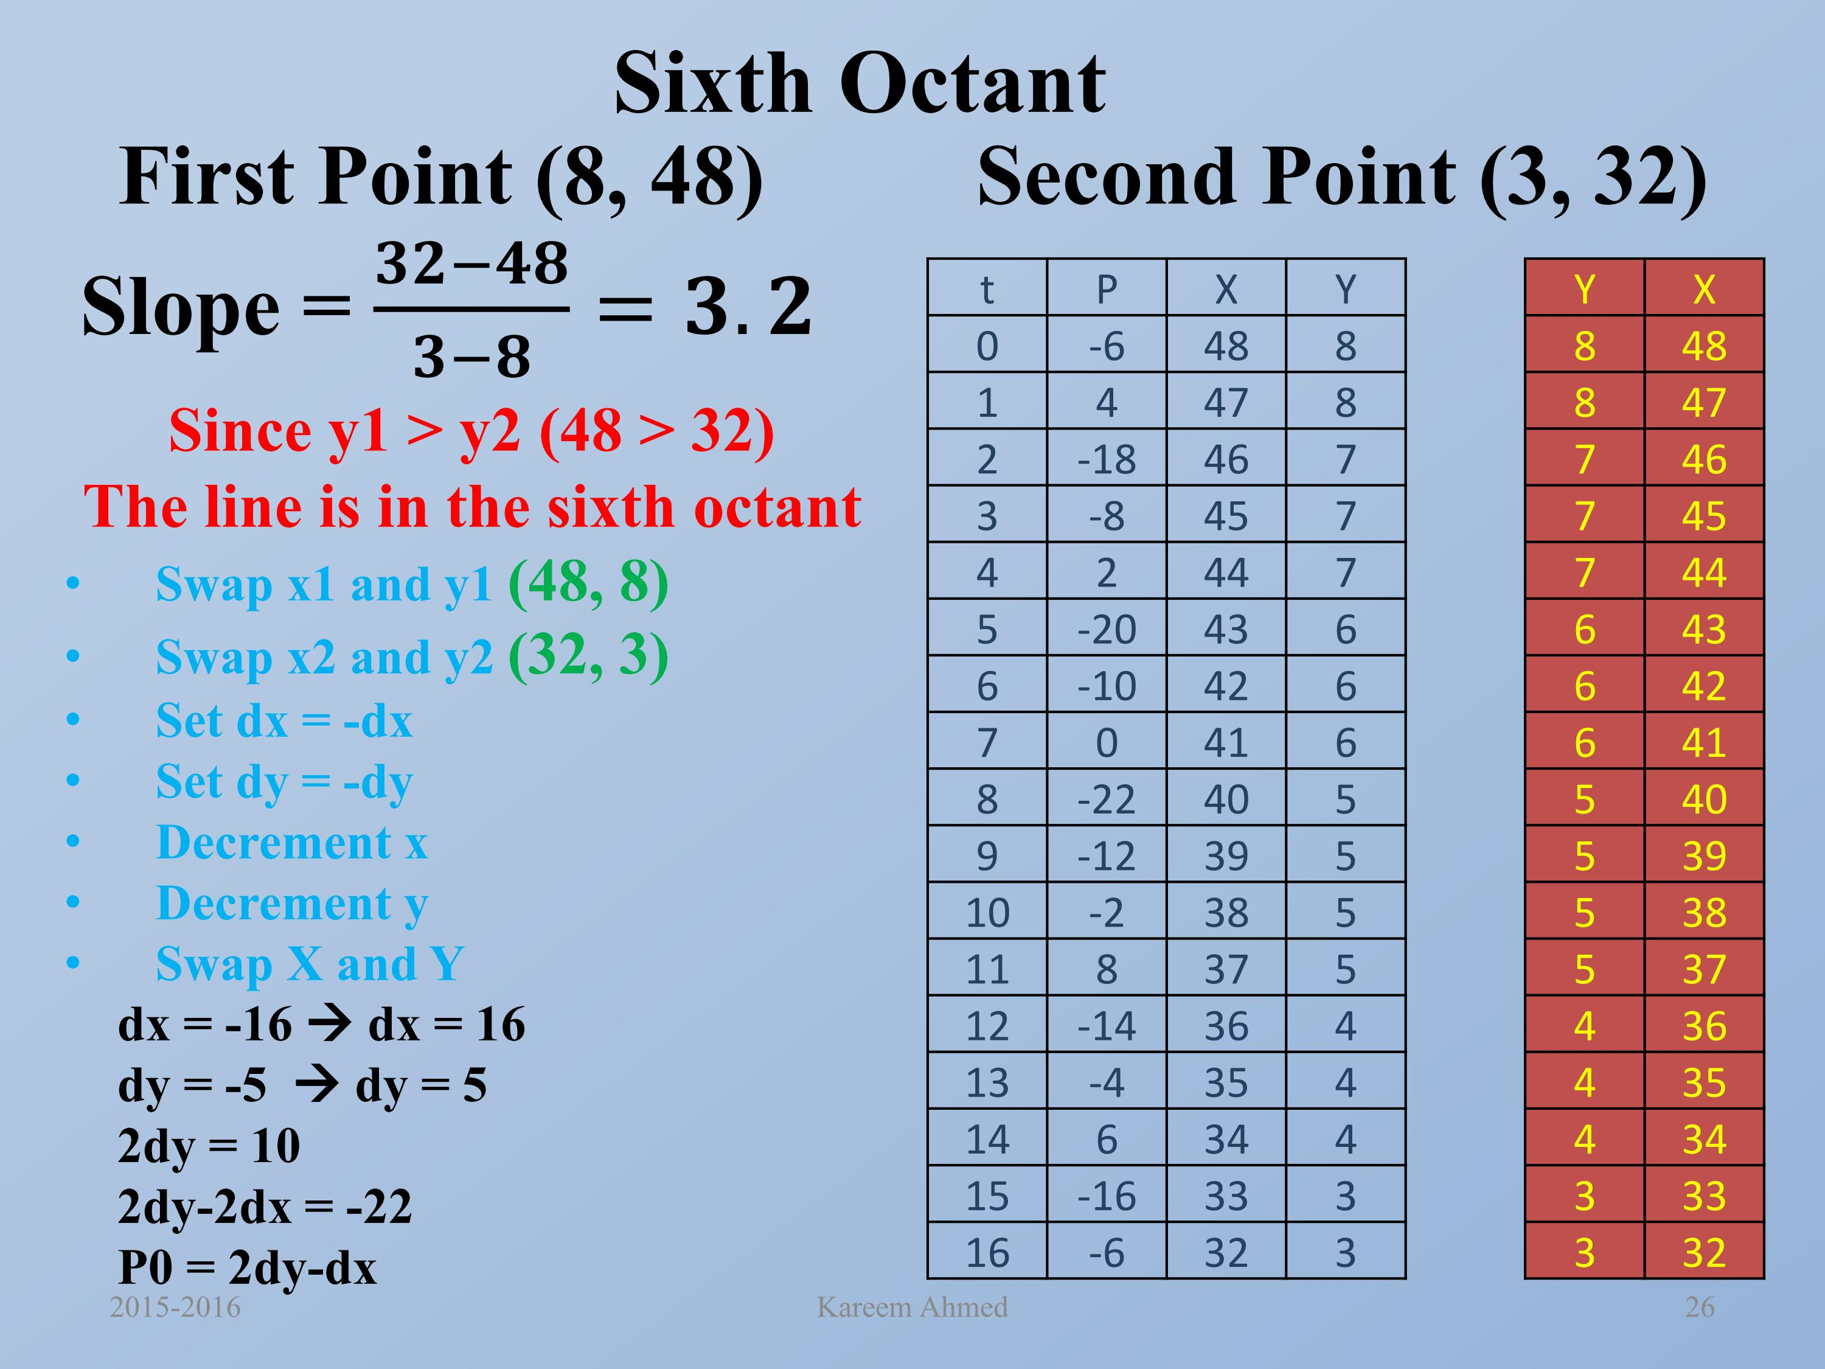
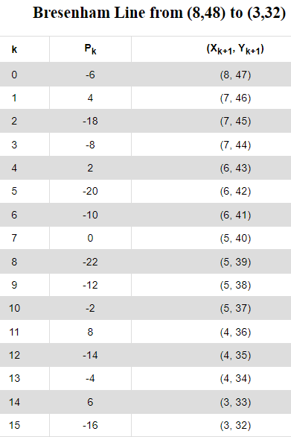

Slide 31
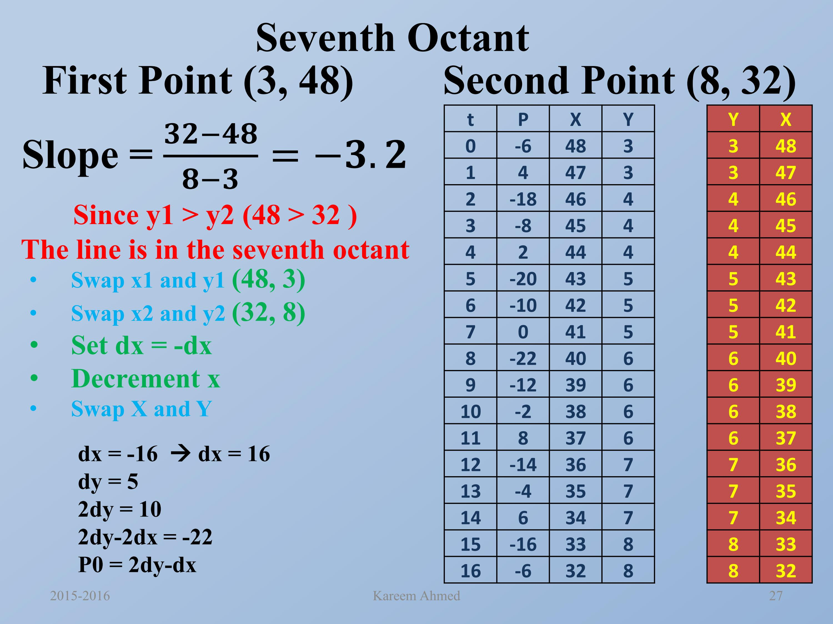
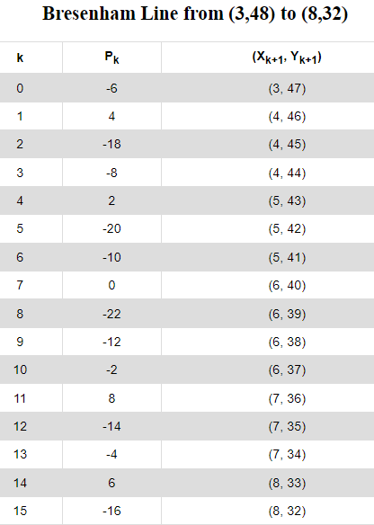

Slide 32
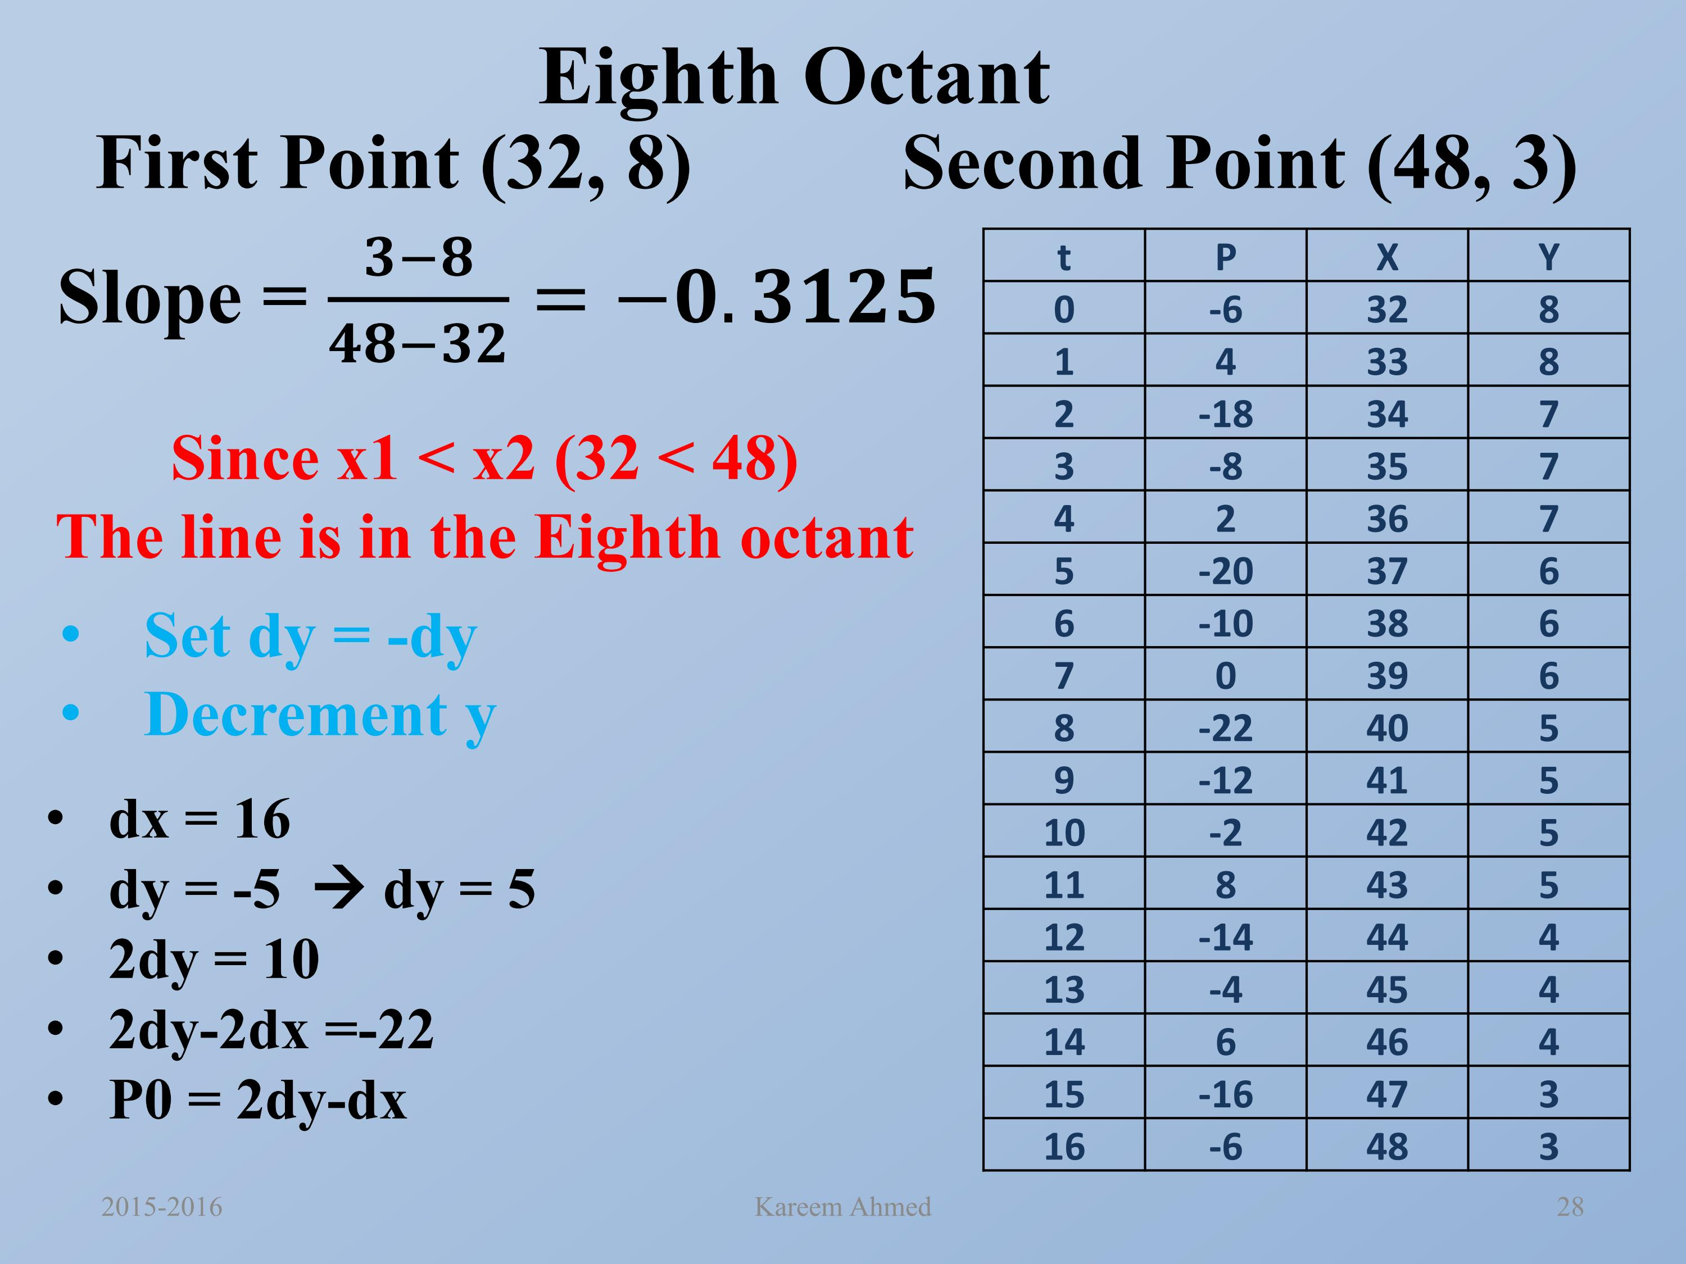
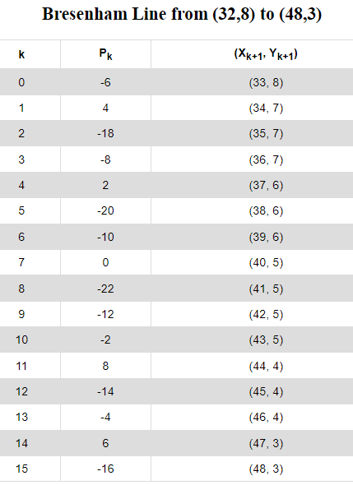

Slide 33
